Slide 1
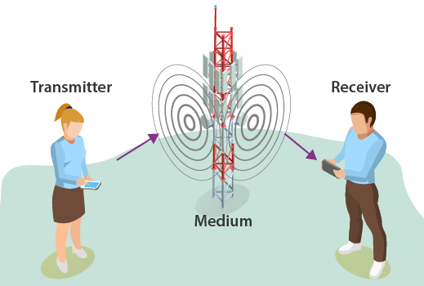

23AID203-Software-defined Communication System Unit-2
Sirisha Tadepalli

Slide 2
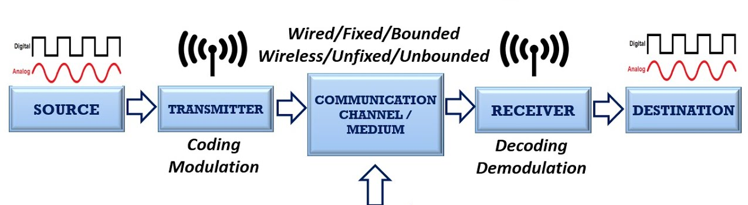
How is the information exchanged between two points?
Encoding
Noise
Fig. Basic block diagram of Communication system [5]

Slide 3
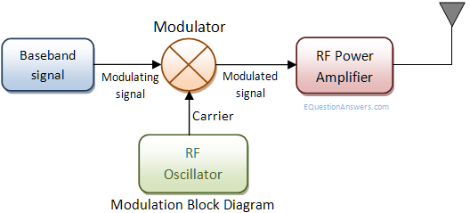
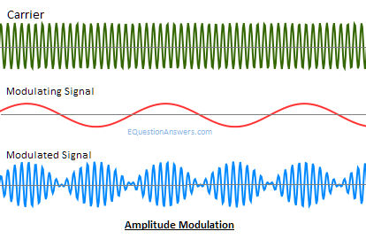
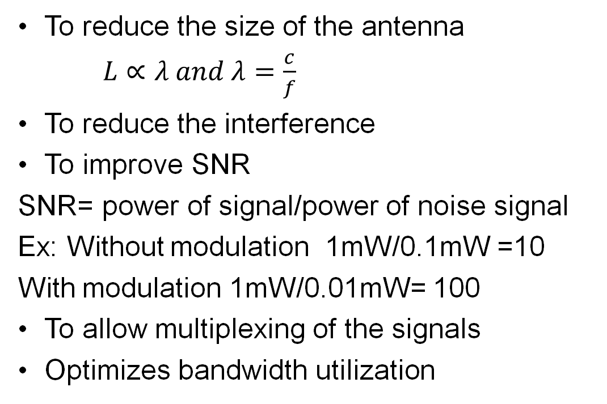
Modulation- (Tx) alters a high-frequency carrier signal's properties with a lower-frequency information signal, enabling long-distance transmission through various media and channels.
Necessity of Modulation
To reduce the size of the antenna
$L∝λ and λ=\frac{c}{f}$
To reduce the interference
To improve SNR
SNR= power of signal/power of noise signal
Ex: Without modulation 1mW/0.1mW =10
With modulation 1mW/0.01mW= 100
To allow multiplexing of the signals
Optimizes bandwidth utilization
Fig. 4 Basic block diagram of modulation [6]
Fig. 5 Amplitude modulation [6]
Notes:
: Modulation improves the signal-to-noise ratio, enhancing the quality and clarity of the transmitted signal.
Modulation optimizes bandwidth utilization, enabling more data transmission within the same bandwidth constraints.

Slide 4
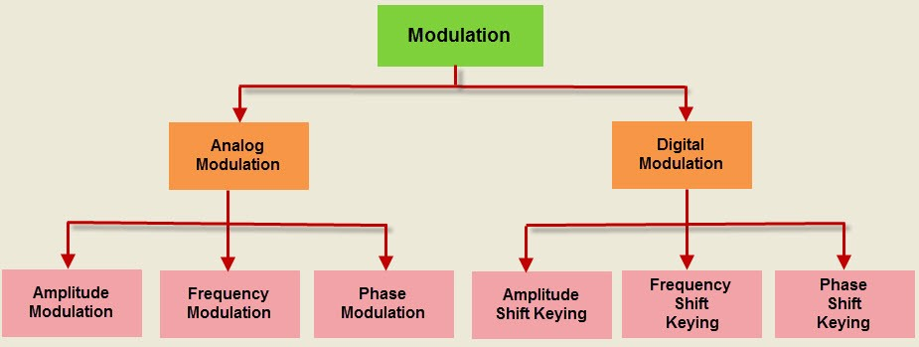
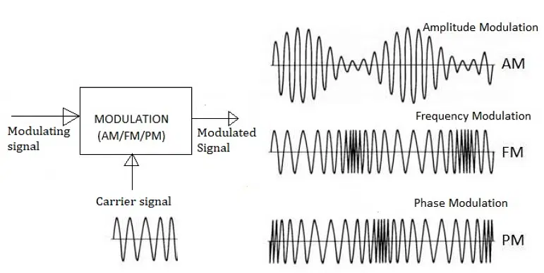
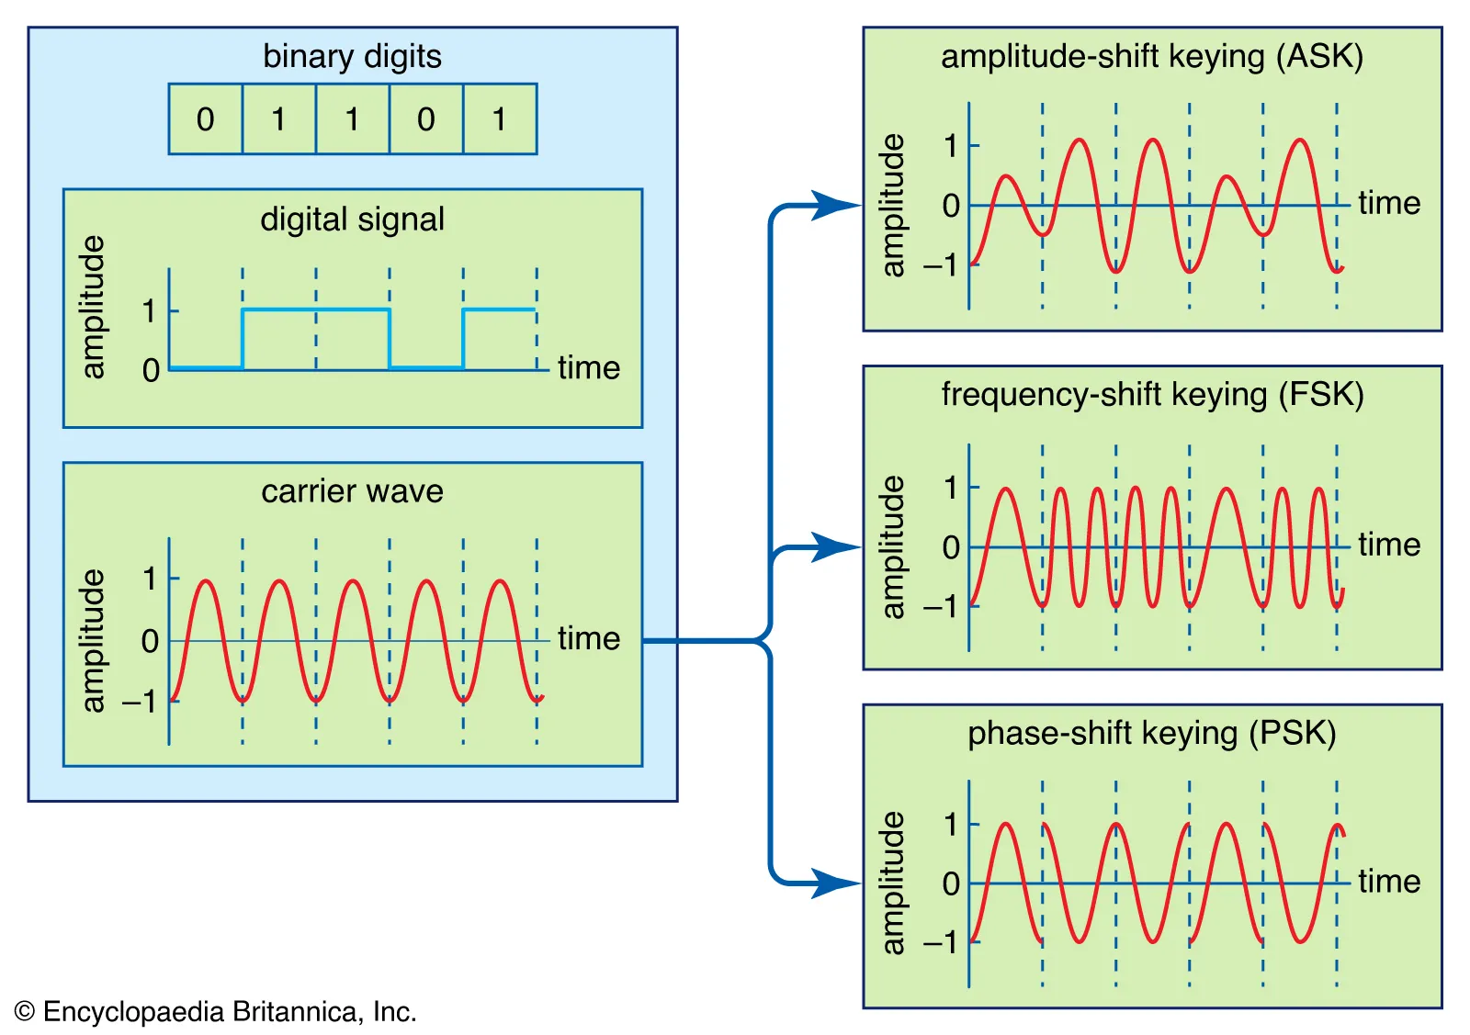
Types of Modulation
Notes:
https://www.youtube.com/watch?v=mHvV_Tv8HDQ
Speech signal: 3kHz, Audible spectrum 20 to 20 kHz

Slide 5
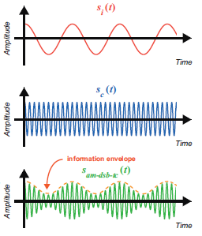
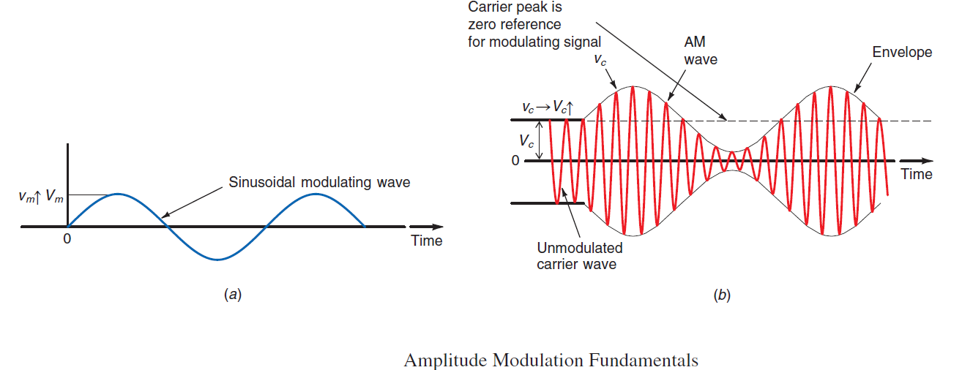
Analog Modulation (AM)
AM, the information signal varies the amplitude of the carrier sine wave
The instantaneous value of the carrier amplitude changes in accordance with the amplitude and frequency variations of the modulating signal
The carrier frequency remains constant during the modulation process, but its amplitude varies in accordance with the modulating signal

Slide 6
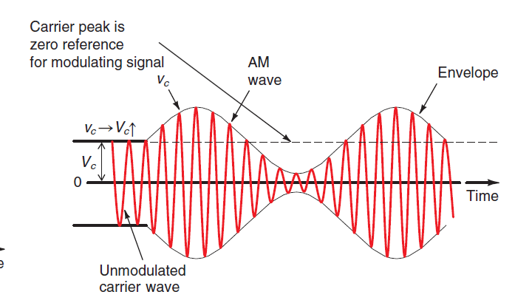
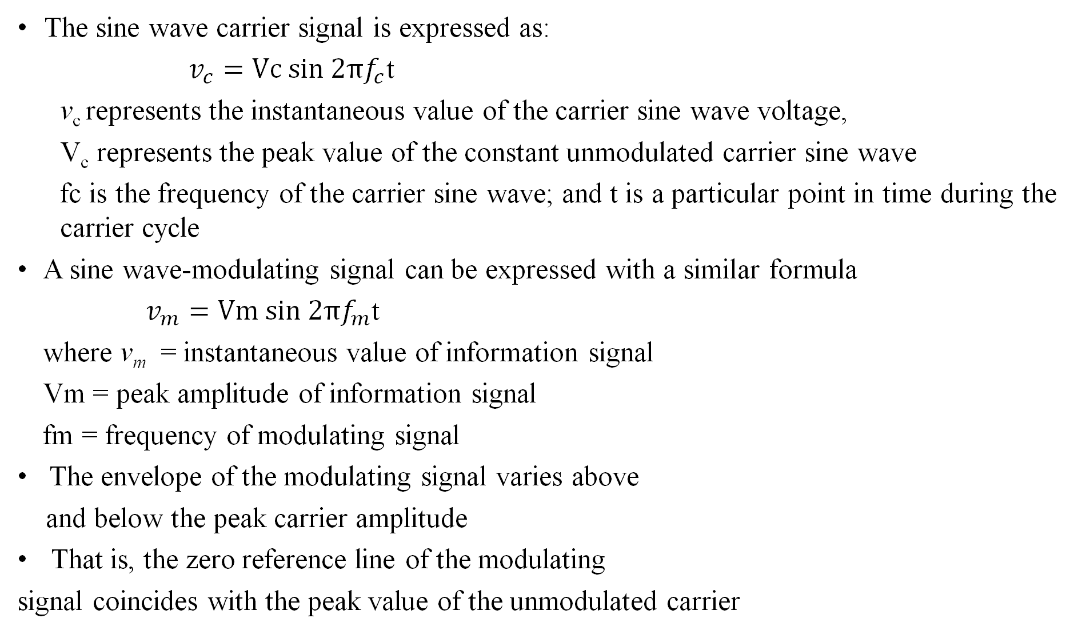
The sine wave carrier signal is expressed as:
$v_{c}=Vc sin 2πf_{c}$t
v_{c} represents the instantaneous value of the carrier sine wave voltage,
V_{c} represents the peak value of the constant unmodulated carrier sine wave
fc is the frequency of the carrier sine wave; and t is a particular point in time during the carrier cycle
A sine wave-modulating signal can be expressed with a similar formula
$v_{m}=Vm sin 2πf_{m}$t
where v_{m} = instantaneous value of information signal
Vm = peak amplitude of information signal
fm = frequency of modulating signal
The envelope of the modulating signal varies above
and below the peak carrier amplitude
That is, the zero reference line of the modulating
signal coincides with the peak value of the unmodulated carrier

Slide 7
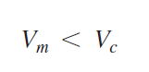
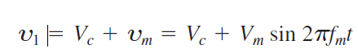
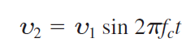
In amplitude modulation, it is particularly important that the peak value of the modulating signal be less than the peak value of the carrier
The value of the modulating signal is added to or subtracted from the peak value of the carrier:
Which expresses the fact that the instantaneous value of the modulating signal algebraically adds to the peak value of the carrier
The instantaneous value of the complete modulated wave v₂ by substituting v₁ for the peak value of carrier voltage Vc as follows:

Slide 8
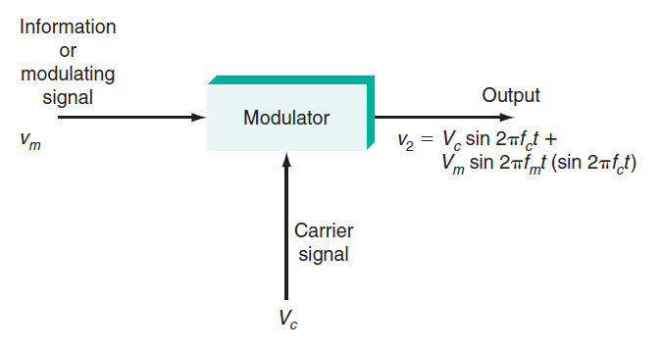
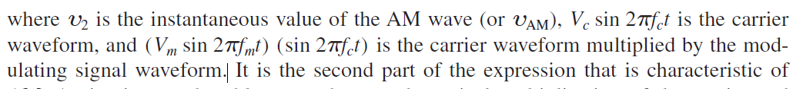
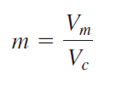
AM
Modulation index m (also called the modulating factor or coeficient, or the degree of modulation)
Multiplying the modulation index by 100 gives the percentage of modulation

Slide 9
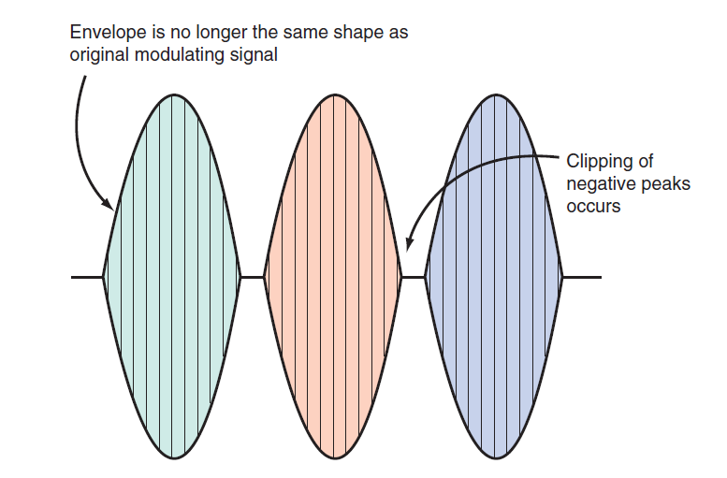
During over-modulation the received signal will produce an output waveform in the shape of the envelope, which in this case is a sine wave whose negative peaks have been clipped off
The ideal condition for AM is when Vm = Vc, or m = 1, which gives 100 percent modulation
Automatic circuits called compression circuits solve this problem (over-modulation) by amplifying the lower-level signals and suppressing or compressing the higher-level signals.
The result is a higher average power output level without over-modulation.
Over modulation → Vm > Vc

Slide 10
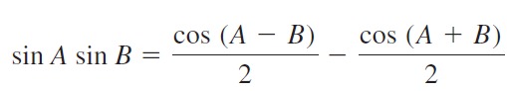
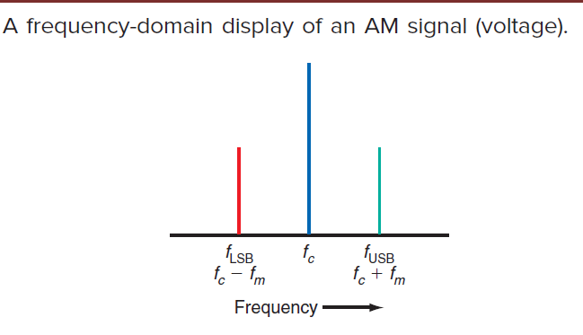
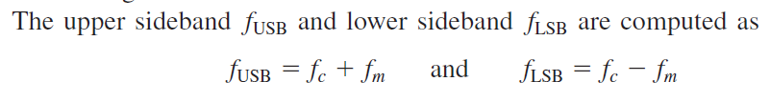
Sideband Calculations
When only a single-frequency sine wave modulating signal is used, the modulation process generates two sidebands.
If the modulating signal is a complex wave, such as voice or video, a whole range of frequencies modulate the carrier, and thus a whole range of sidebands are generated.
The existence of sidebands can be demonstrated mathematically, starting with the equation for an AM signal described previously:

Slide 11
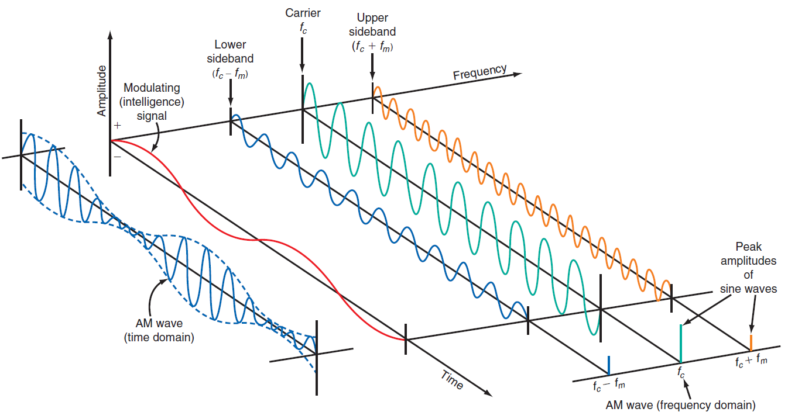
Time and Frequency domains of AM signal

Slide 12
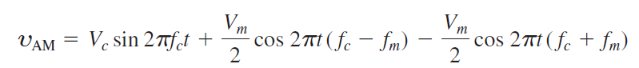
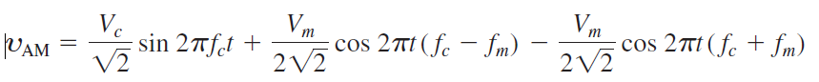
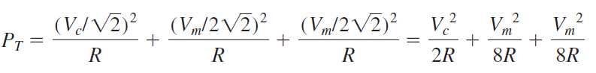
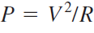
AM-Power
The AM signal is a composite of several signal voltages, namely, the carrier and the two sidebands, and each of these signals produces power in the antenna
The total transmitted power P_{T} is simply the sum of the carrier power P_{c} and the power in the two sidebands P_{USB} and P_{LSB} :
P_{T} = P_{c} + P_{USB} + P_{LSB}
Original AM signal
For power calculations, rms values must be used for the voltages
Convert the voltages from peak to rms by dividing the peak value by √2 or multiplying by
0.707
since

Slide 13
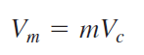
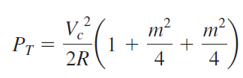
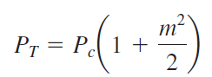
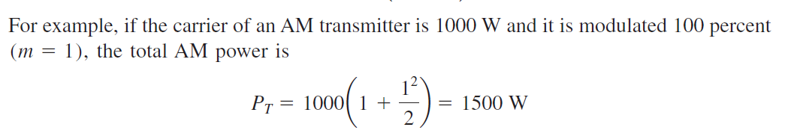
Since m= Vm/Vc , the modulating signal be expressed as follows:
Therefore,
»
Problem-1
An AM transmitter has a carrier power of 30 W. The percentage of modulation is
85 percent. Calculate (a) the total power and (b) the power in one sideband.
Notes:
PT = 30(1.36125) = 40.8 W
PT - Pc = 40.8 -30 = 10.8 W

Slide 14
Types of AM
Double Sideband (AM-DSB)
Single Sideband (AM-SSB)
Vestigial Sideband (AM-VSB
Types of AM-DSB
Suppressed Carrier (AM-DSB-SC)
Transmitted Carrier (AM-DSB-TC)

Slide 15
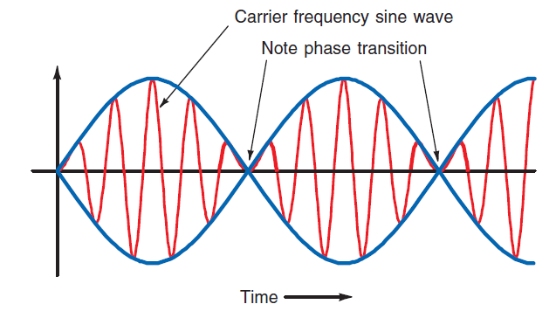
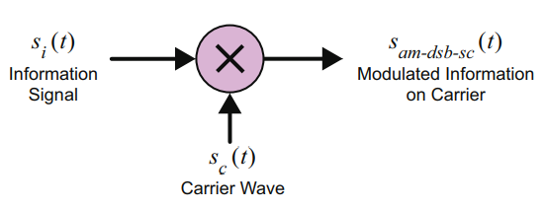
AM-DSB-SC
In amplitude modulation, two-thirds of the transmitted power is in the carrier, which conveys no information
The benefit is that no power is wasted on the carrier
DSB signal is a sine wave at the carrier frequency, varying in amplitude
The information signal is mixed with a carrier wave to produce the AM-DSB-SC signal
DSB-SC
DSB-FC

Slide 16
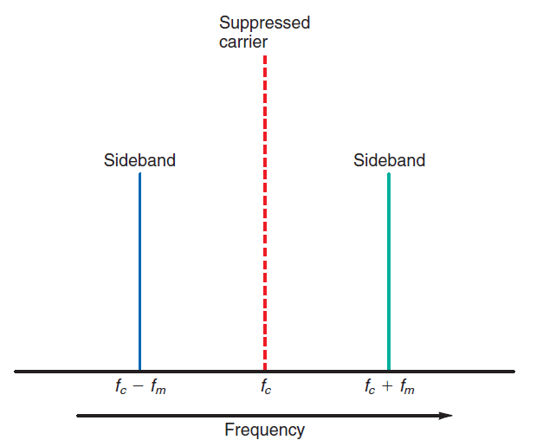
A unique characteristic of the DSB signal is the phase transitions that occur at the lower-amplitude portions of the wave
DSB-SC is an amplitude modulation wave without the carrier, therefore reducing power waste, giving it a 50% efficiency
One important application for DSB, however, is the transmission of the color information in a TV signal
DSB-SC

Slide 17
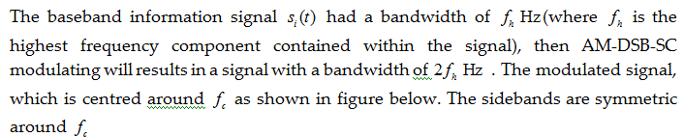
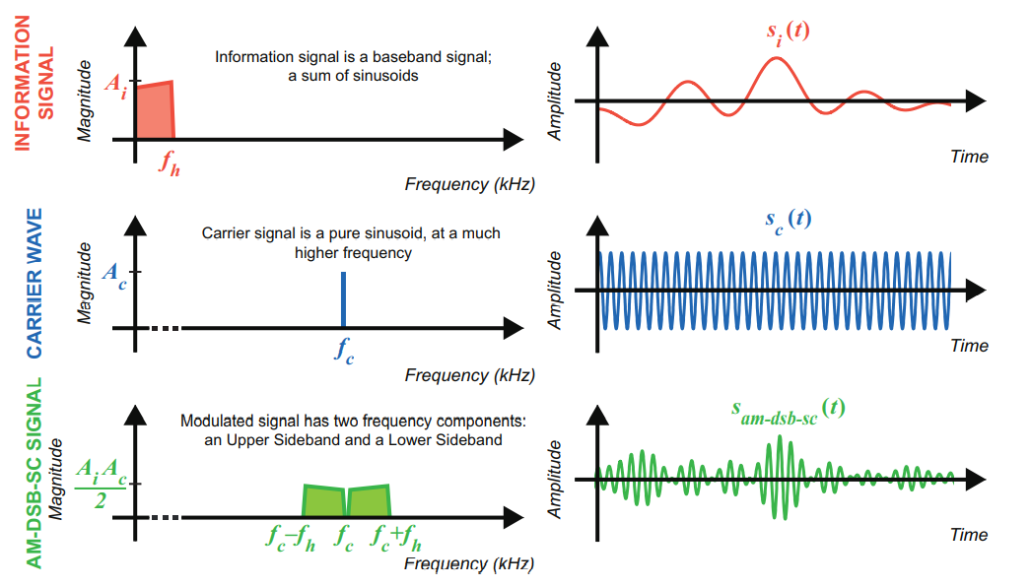
AM-DSB-SC: Modulating baseband signals

Slide 18
Transmission efficiency of AM wave
Transmission efficiency is defined as the ratio of the power carried by the sidebands to the total transmitted power

Slide 19
AM-SSB: Single Sideband AM
Though mathematically simple, AM-DSB modulation is spectrally inefficient because the process creates a pair of identical sidebands
This means the signals have a wider bandwidth than is strictly necessary to carry the information
Therefore, if only a finite amount of bandwidth is available in a communication channel, this would not be the best choice
The main advantage of AM-SSB modulation is the bandwidth occupied by the modulated signal is the same as the bandwidth of the baseband signal

Slide 20
One sideband can be suppressed; the remaining sideband is called a single sideband suppressed carrier (SSSC or SSB) signal.
SSB signals offer four major benefits
The primary benefit of an SSB signal is that the spectrum space it occupies is only one-half that of AM and DSB signals. This greatly conserves spectrum space and allows more signals to be transmitted in the same frequency range.
The single sideband channeled all previously devoted power to the carrier and other sidebands, resulting in a stronger signal that can be reliably received at greater distances.
Alternatively, SSB transmitters can be made smaller and lighter than an equivalent AM or DSB transmitter because less circuitry and power are used.
Because SSB signals occupy a narrower bandwidth, the signal’s noise is reduced.
There is less selective fading of an SSB signal over long distances

Slide 21
Types AM-SSB
Single Upper Sideband (AM-SUSB)
Single Lower Sideband (AM-SLSB)
The upper and lower sidebands of AM-SSB signals have very similar envelopes
AM-SSB modulation results in the modulated signal of same bandwidth as that of the baseband information signal

Slide 22
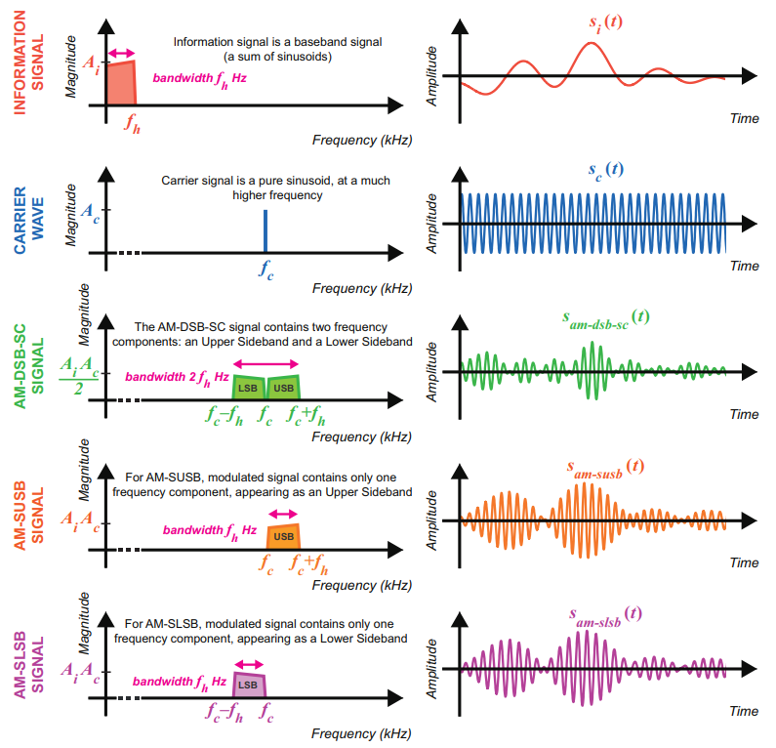
Comparison
of AM-DSB-SC,
AM-SUSB,
AM-SLSB signals

Slide 23
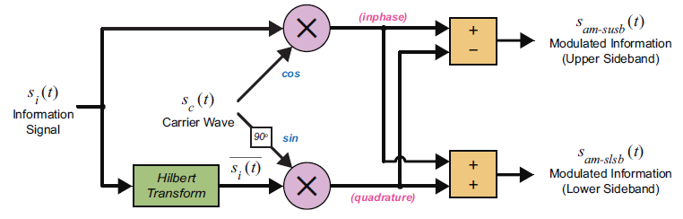
Generation of AM-SSB signals
Figure: Block diagram of AM-SSB modulator

Slide 24
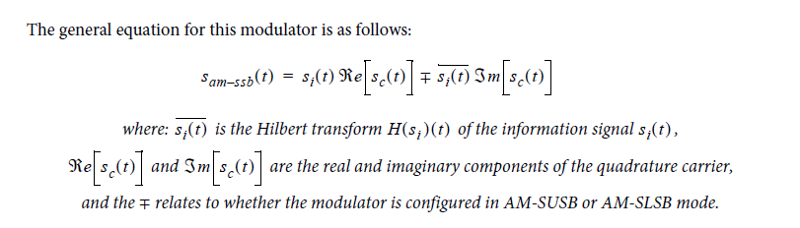

Slide 25
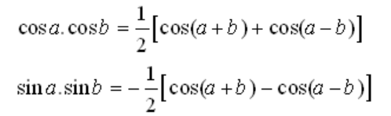
AM-SSB: Modulating a sine wave
Information signal
HT of message signal
The quadrature carrier wave has the form
The AM-SSB modulated signal is obtained as

Slide 26
The configuration required to generate AM-SUSB is
The configuration required to generate AM-SLSB is

Slide 27
Revisit: Hilbert Transform
Hilbert transform convert cosine function into sine function (90 degree phase shift) to help us to create a complex exponential signal of the form
Analytical signal
How do we generate a given
This is done by convolution of with
So, the analytical signal corresponding to

Slide 28
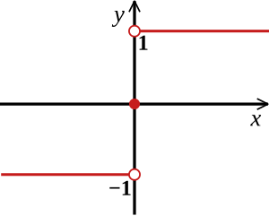
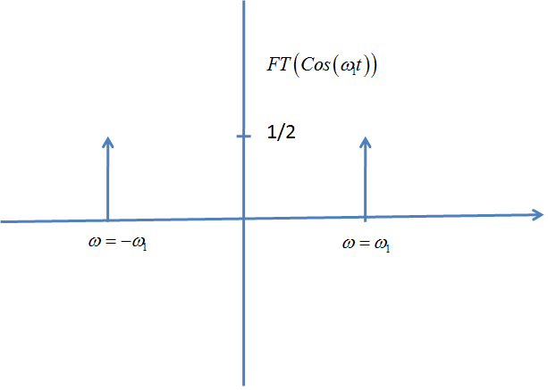
We know,
Sgn(w)
Convolution in the time domain is equivalent to multiplication in the frequency domain

Slide 29
Pros and Cons. of SSB
Advantages
Half the bandwidth is required compared to AM-DSB signals
Due to suppression of carrier and one sideband power is saved
Reduced noise interference due to the reduced bandwidth
Disadvantages
The generation and reception of SSB signals are complex
SSB transmitter and receiver need to have an excellent frequency stability
SSB modulation is highly complex and expensive to implement

Slide 30
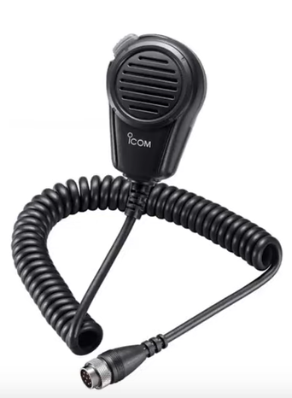
Applications of SSB
Used at HF segment of the spectrum
SSB modulation is used in applications where power saving is required
SSB is also used in low bandwidth required applications (eg: point-to-point communication, telemetry, military applications, radio navigation etc)
When single-sideband is used in amateur radio voice communications, it is common practice that for frequencies below 10 MHz, lower sideband (LSB) is used and for frequencies of 10 MHz and above, upper sideband (USB) is used

Slide 31
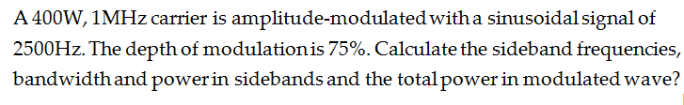

Slide 32
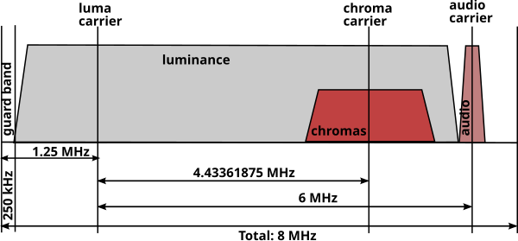
Phase Alternating Line (PAL)- Video transmission
PAL is a composite video because luminance (luma, monochrome image) and chrominance (chroma, color applied to the monochrome image) are transmitted as one signal.

Slide 33
AM-VSB: Vestigial sideband AM
Created to reduce the spectral requirements of analog TV
Apply BPF to AM-DSB-TC signals to suppress most of the sidebands to reduce bandwidth
This partial sideband is called the vestigial sideband
In VSB, one sideband and a part of the other sideband called vestige is transmitted
The bandwidth requirement is slightly higher than SSB
VSB is used in the transmission of TV signals
Easy to implement than SSB

Slide 34
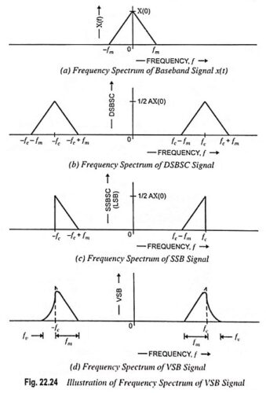
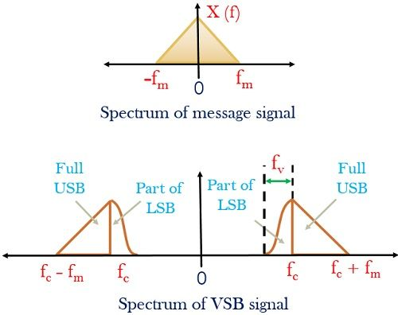

Slide 35
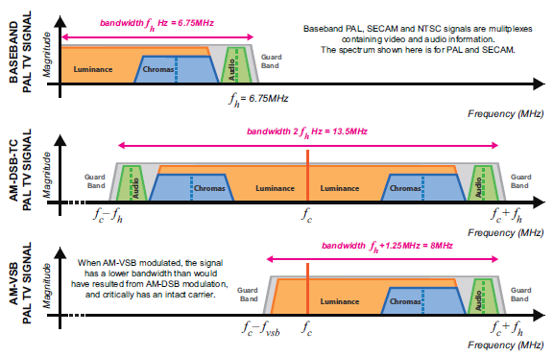
Frequency domain plots showing PAL/SECAM TV signal first
Being AM-DSB-TC modulated then AM-VSB modulated
Notes:
https://www.sciencedirect.com/science/article/abs/pii/B9780323917728000132

Slide 36
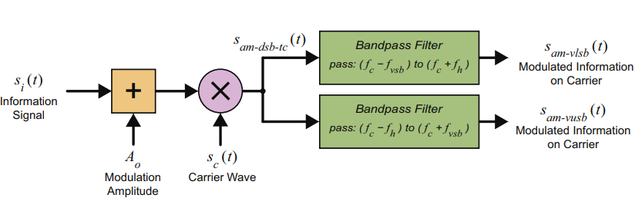

Slide 37
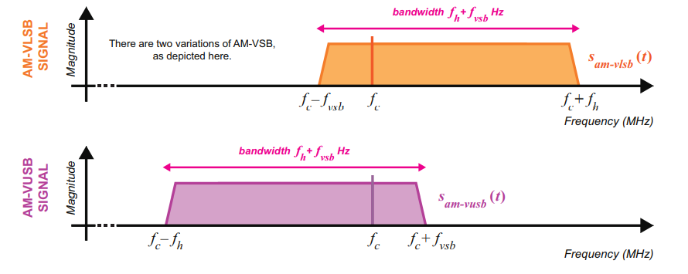

Slide 38
AM Demodulation
Coherent demodulation –
which involves synthesizing a sine wave with the same frequency and phase as the carrier of the received signal and using it to demodulate the received signal
Non-coherent demodulation –
The receiver carrier need not be in phase locked with the transmitter carrier

Slide 39
Coherent AM Demodulation
To demodulate an AM signal, a recover must multiply the received signal with a sine wave that has exactly the same frequency and phase as the carrier embedded within it
The mixing operation shifts the modulated information from being centred around carrier frequency, back to baseband
This approach → synchronous demodulation

Slide 40
Demodulation of single-tone AM-DSB-SC signals
DSB-SC signal
For demodulation, mix the signal with

Slide 41
LPF removes the high frequency components and resulting in the scaled information signal as
The frequency and phase of the modulating and demodulating sines will not always match exactly when there is offset. Thus, this demodulation scheme becomes unsuccessful

Slide 42

Non-coherent AM demodulation- The envelope detector
Simplest form of non-coherent demodulator in the analog domain
3 components : diode, resistor and capacitor
Can be used only to demodulate AM-DSB-TC

Slide 43

During the +ve half cycle diode conducts and the capacitor charges to the peak voltage
During –ve half cycle capacitor discharges
1/fc << RC<<1/fm
Because the capacitor charges and discharges, the recovered signal has a small
amount of ripple on it, distorting of
the modulating signal
Distortion of the original signal can occur if the time constant of the load resistor R1
and the shunt filter capacitor C1 is too long
or too short
If the time constant is too long, the capacitor discharge will be too slow to follow the faster changes in the modulating signal. This is referred to as diagonal distortion.

Slide 44



Slide 45


Frequency Modulation (FM)
In FM, the carrier amplitude remains constant and the carrier frequency is changed by the modulating signal
As the modulating signal amplitude increases, the carrier frequency increases.
If the amplitude of the modulating signal decreases, the carrier frequency decreases
The amount of change in carrier frequency produced by the modulating signal is known as the frequency deviation f_{d}.
Maximum frequency deviation occurs at the maximum amplitude of the modulating signal.
FM scheme is used for commercial radio stations due to its high resilience to additive noise

Slide 46
The frequency of the modulating signal determines the frequency deviation rate, or how many times per second the carrier frequency deviates above and below its center frequency.
If the modulating signal is a 500-Hz sine wave, the carrier frequency shifts
above and below the center frequency 500 times per second.
Assume a carrier frequency of 150 MHz. If the peak amplitude of the modulating signal causes a maximum frequency shift of 30 kHz.
The carrier frequency will deviate up to 150.03 MHz and down to 149.97 MHz.
The total frequency deviation is 150.03 −149.97 5 0.06 MHz = 60 kHz.
Example:
A transmitter operates on a frequency of 915 MHz. The maximum FM deviation is ±12.5 kHz. What are the maximum and minimum frequencies that occur during modulation?

Slide 47

Frequency Modulator
Using a Voltage Controlled Oscillator (VCO) to perform FM

Slide 48

Voltage Controlled Oscillator (VCO)
VCO is an oscillator with a standard or quiescent frequency (f0) and a control input that can adjust the output frequency upwards or downwards from the quiescent value
Eq 1.1

Slide 49




Eq 1.2
, Eq 1.1 becomes
Eq 1.3

Slide 50

Substituting Eq 1.3 into Eq 1.2 , and replacing with parameters of an FM carrier signal, we get the FM signal as follows
Eq 1.4

Slide 51

FM: Modulating a sine wave
Information signal
Inputting this signal into the VCO’s control port, the phase θ at time t becomes,
W_{i} = 2πfi

Slide 52

The frequency-modulated signal is

Slide 53

In FM a large number of pairs of upper and lower sidebands are generated.
As a result, the spectrum of an FM or a PM signal is usually wider than that of an equivalent AM signal
Note that the sidebands are spaced from the carrier fc and one another by a frequency equal to the modulating frequency
fm.
Frequency spectrum of FM signal

Slide 54
Theoretically, the FM process produces an infinite number of upper and lower sidebands and a theoretically infinitely large bandwidth.
The ratio of the frequency deviation to the modulating frequency is known as the modulation index mf or β_{fm} :
β_{fm} = f_{d}/f_{m}
where f_{d} is the frequency deviation and f_{m} is the modulating frequency.
For example, if the maximum frequency deviation of the carrier is ±12 kHz and the maximum modulating frequency is 2.5 kHz, the modulating index is β_{fm} = f_{d}/f_{m} = 12/2.5 = 4.8
Ex: What is the deviation ratio of TV sound if the maximum deviation is 25 kHz and the maximum modulating frequency is 15 kHz?

Slide 55
Types of FM
Narrowband FM
Wideband FM
The classification is based on the modulation index
Narrowband FM (NFM) β_{fm} << π/2 or 1
Wideband FM (WFM) β_{fm} >> π/2 or 1

Slide 56

Narrowband FM (NFM)
We know,
By using sum-to-difference trigonometric identity,
For minimal values of or m_{fm}, we assume
Thus,
This equation closely resembles the equation of the AM-DSB-TC signal.
$$≅$$
$$≅$$

Slide 57

Narrowband FM (NBFM) Generation

Slide 58

NFM signal is essentially the same as the AM-DSB-TC signal, with the one difference that its lower sideband (LSB) is inverted.
That is the LSB of the NFM signal is 180 degrees out of phase with the lower sideband of the AM-DSB-TC signal
The spectra of NFM and AM-DSB-TC are similar meaning that the bandwidths of these two signals are approximately the same.

Slide 59
Advantages of FM over AM
Improved Signal-to-Noise Ratio (SNR) FM is less susceptible to noise compared to AM. In FM, the information is carried by the frequency variations, whereas in AM, it is carried by the amplitude. Since most noise in communication systems affects amplitude, FM signals are less affected, leading to better sound quality and a higher signal-to-noise ratio.FM is beneficial in environments with interference or background noise, such as urban areas.
Better Sound Quality: FM generally provides better sound quality than AM. The wider bandwidth used by FM allows for higher fidelity and more accurate reproduction of audio signals. This is why FM is commonly used for high-fidelity music broadcasts.FM can carry a greater range of frequencies, resulting in a better listening experience for music and speech.
Reduced Distortion FM is less prone to signal distortion than AM. Since amplitude variations in AM can be easily distorted by noise or fading, this leads to distortions in the received signal. FM avoids this issue as the amplitude remains constant, and only frequency changes carry information.

Slide 60
Capture Effect FM receivers experience a phenomenon called the capture effect, where they tend to lock onto the strongest signal and ignore weaker ones. This makes FM less prone to interference from other stations broadcasting at nearby frequencies, unlike AM, where interference from adjacent stations can be a problem.
Constant Transmitted Power In FM, the power of the transmitted signal is constant, regardless of the modulation index or the complexity of the modulating signal. In AM, the power of the transmitted signal varies with the amplitude of the modulating signal, which means that AM transmission can be less power-efficient.
Wider Bandwidth: Although FM requires a wider bandwidth compared to AM, this is an advantage in certain situations. Wider bandwidth in FM allows for the transmission of additional information, such as stereo sound in radio broadcasts and higher-quality audio.
Resilience to Fading: FM is more resistant to fading, which is caused by multiple path propagation of signals (when radio waves reflect off objects like buildings or mountains). In AM, such effects cause variations in signal strength, leading to a distorted signal, while FM's constant amplitude makes it more immune to such issues.
Better for Long-Distance Broadcasting: FM is less affected by changes in atmospheric conditions than AM, leading to more reliable long-distance communication, especially when using repeaters.

